Slide 1
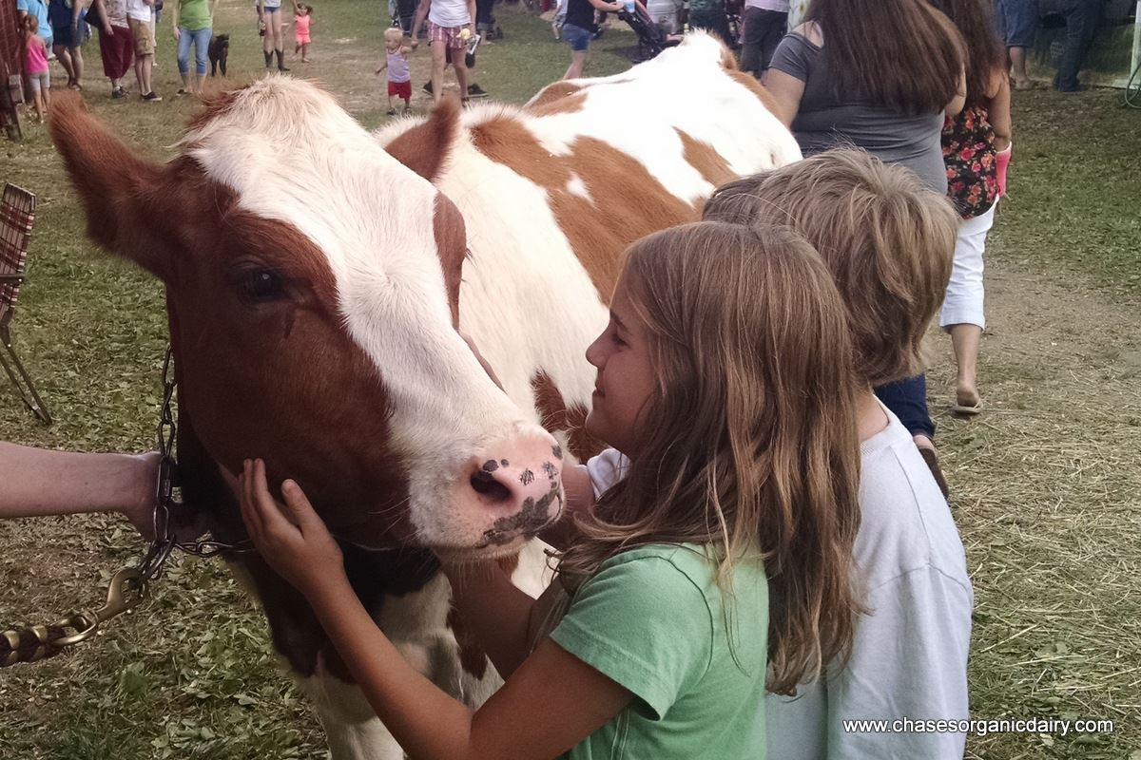

Healthy Animals, Healthy People
How to Prevent the Spread of
Zoonotic Diseases at Farms & Fairs
Notes:
Hi everyone. I would like to personally thank all of you for attending and being here with us today. Without you guys, our workshop would not be successful. Before we get started, I’d like to introduce myself a little bit.
My name is Brooke Chase and most of you probably spoke with me on the phone at least once throughout the past couple of months! I grew up in Aroostook County, Maine and was born and raised on my family’s 100 cow dairy farm. I have always been really involved in the farm and in agriculture. I’ve participated in my local 4-H and then FFA in my high school years. I’ve also been involved in my local fair, the Northern Maine Agricultural Fair, for a lot of my life, both by helping out my family as well as showing cows and eventually bringing my own herd to the fair the past couple of years! I’m glad that I was given the opportunity to be involved in this program and I hope by the end of this, you will be too. I know a lot of you have animals to get back to as do I, so let’s get started!

Slide 2
Overview/Agenda
Overview
  Project
  Zoonotic Disease & Vocab
Influenza
  Pathogens
  Symptoms
  Prevention
Enteric Diseases
  Pathogens & Symptoms
  Prevention
4. Handwashing
Biosecurity
  - At the Farm
  - At the Fair
  - Quarantine
Careers in Public Health
Closing
Notes:
Today we are going to cover several topics. I will give everyone the opportunity to ask any questions after each of the main sections as well as at the end. If anyone has questions about anything during the PowerPoint, feel free to raise a hand or speak up!

Slide 3
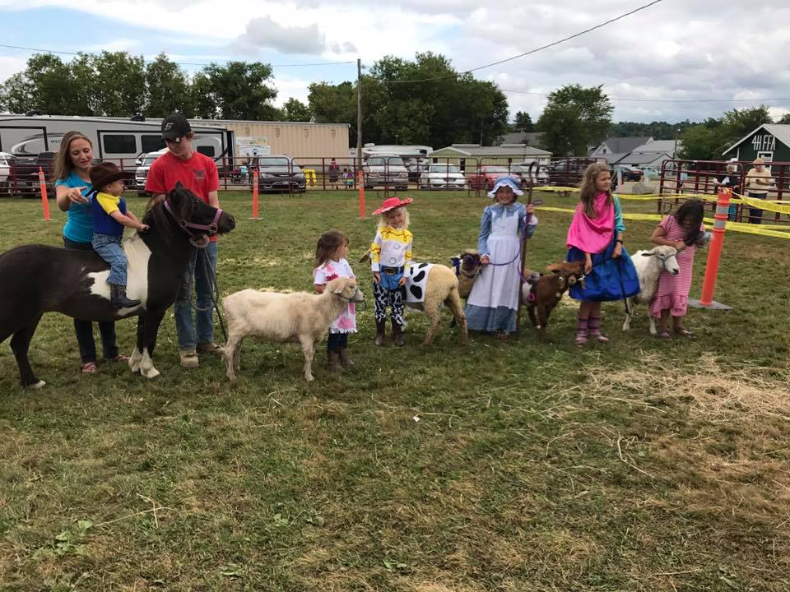
Project Goals & Purpose
  Reduce disease in animals
  and humans
  Increase disease
  prevention
  awareness
We want YOU to be the teacher!
Notes:
Our main goal here is to reduce disease in animals and humans and increase disease prevention awareness! Prevention is truly the key here as a lot of these diseases do not have true cures and cannot be vaccinated against.
Some of you may already be familiar with this information and that is because this PowerPoint was designed to help teach children as well. For this program to be successful, we really need your help to pass this information along to the younger generation. I know some of you here were involved with the 2015/2016 program in which we educated kids directly on zoonotic disease and prevention. This year, we are doing the same thing but we are putting the tools to educate them in YOUR hands. We hope that all of you will use the information in this PowerPoint along with the materials we will discuss after to help educate other people. We encourage you to spread this information to other 4-H groups, FFA groups, or really anyone, young or old. These resources will remain available to you indefinitely and we will be here to help you with anything you need, whether that be more materials or any questions regarding this information.
With that being said, lets jump right into it!

Slide 4

One Health Triad
Animal health, human health, and environmental health are all connected
All aspects must be healthy to truly lower risk of disease
Notes:
One Health is a way to look at health that combines animals, humans and the environment, and recognizes that the three are all connected. This will be a common trend that we talk about during this PowerPoint, as all three aspects of the triad (humans, animals, and the environment) must all be healthy in order to truly lower the risk of disease locally, nationally, and worldwide. This is not a new concept, however it has become more important as the validity of this model has been verified and a worldwide effort to take a collaborative approach to health has gained speed.

Slide 5
Glossary
Enteric disease – stomach illnesses caused by germs that enter the body through the mouth
Feces/fecal – bodily waste or poop
Fomite: a nonliving object that can carry and spread germs
Host – a living animal or plant that provides food or shelter for another
Immunity – the natural ability of a human or animal to prevent or avoid illness
Immunocompromised/Immunosuppressed – a person or animal with a weak immune system, making them more likely to get sick
Incubation period – the time between when a human or animal is exposed to a germ and when they get sick
Lethargy – a lack of energy
Mutation – a change to the DNA or RNA
Organism – a living plant, animal, or cell
Parasite – a germ that lives on or in a host and can cause harm
Pathogen – germs that can cause illness
Zoonotic diseases – illnesses that can be spread between humans and animals
Notes:
Before we start the discussing the pathogens in detail, let’s go over glossary terms that will be used so we are all on the same page. You should have a glossary list in your packets as well, so please feel free to refer to that as well throughout the presentation if anything comes up that you are unfamiliar with.

Slide 6
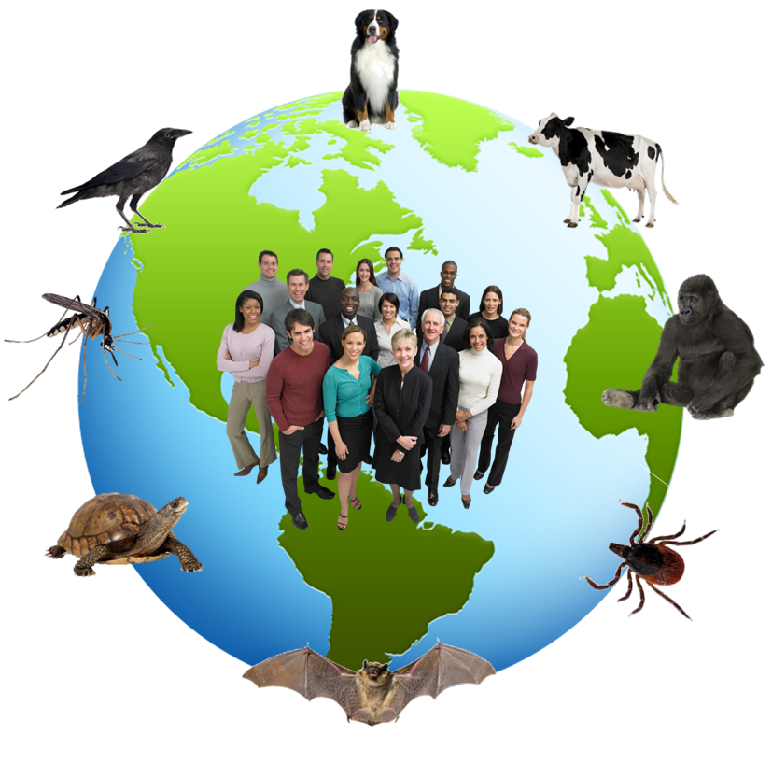
What IS a zoonotic disease?
Zoonotic diseases are diseases which can be spread between animals and humans
  ¾ of all human infectious diseases originated from animals
  ½ of all diseases are zoonotic
Prevention is key
Younger kids, older adults, immunocompromised individuals are most at risk
http://dhhr.wv.gov/oeps/disease/Zoonosis/Pages/default.aspx
Notes:
Chances are, most of you out there have heard of the flu, salmonella, or rabies. These are actually all types of zoonotic diseases. Zoonotic diseases are diseases which can be spread from animals to humans
Even though this is not usually a word you will hear everyday, over half of all human diseases are zoonotic and over ¾ of all human infectious diseases originated from animals.
Prevention is truly the key because most zoonotic diseases cannot be vaccinated against and do not have a cure like we discussed earlier. A lot of these diseases have the potential to become very serious, even in healthy individuals, however there are populations that are much more at risk for serious complications and even death.
Research has shown that children under 5 and especially infants are very much at risk for contacting these diseases and experiencing severe symptoms. Adults 65 and older are also susceptible along with pregnant women. Immunocompromised individuals, or individuals with a weakened immune system, are very much at risk as well.
These people may not be aware of these zoonotic diseases, however they remain ever more deadly. That is why education on zoonotic disease is so important, especially for people who are allowing their animals to interact with the public. If these people are not even aware that these diseases exist, the likelihood of them contracting a disease is even higher.

Slide 7
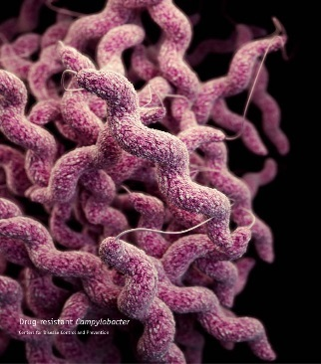
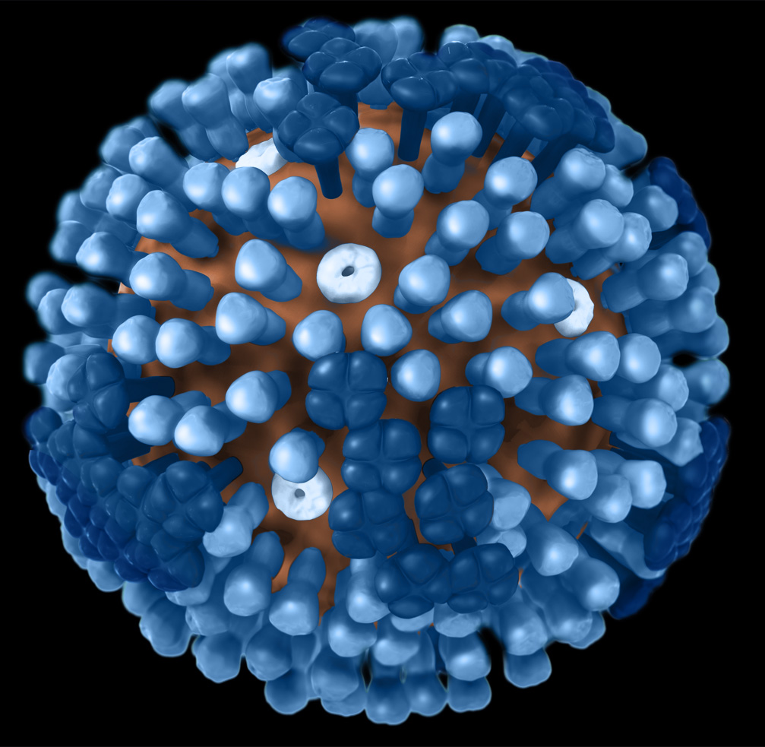
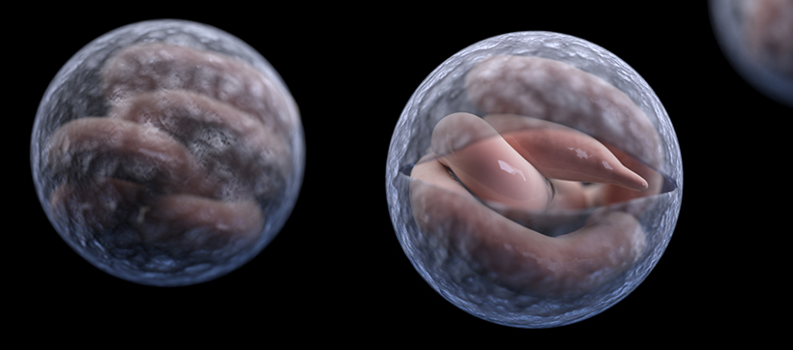
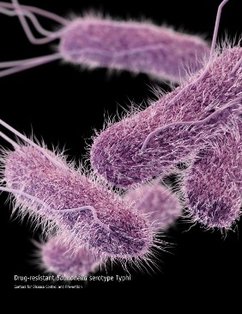
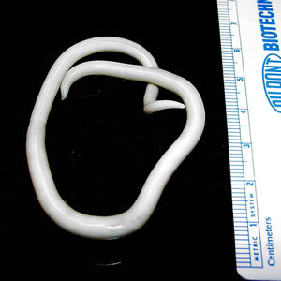
MEET…THE PATHOGENS
Campylobacter | Influenza | Cryptosporidiosis | Salmonella | Ascaris
Notes:
Now that we have discussed the bigger ideologies surrounding animal, human, and environmental health, let’s talk about some of the specific pathogens that cause disease.
Reminder: A pathogen is any disease causing agent, whether that be a bacteria, virus, or parasite. Pathogens are what actually makes you sick.

Slide 8
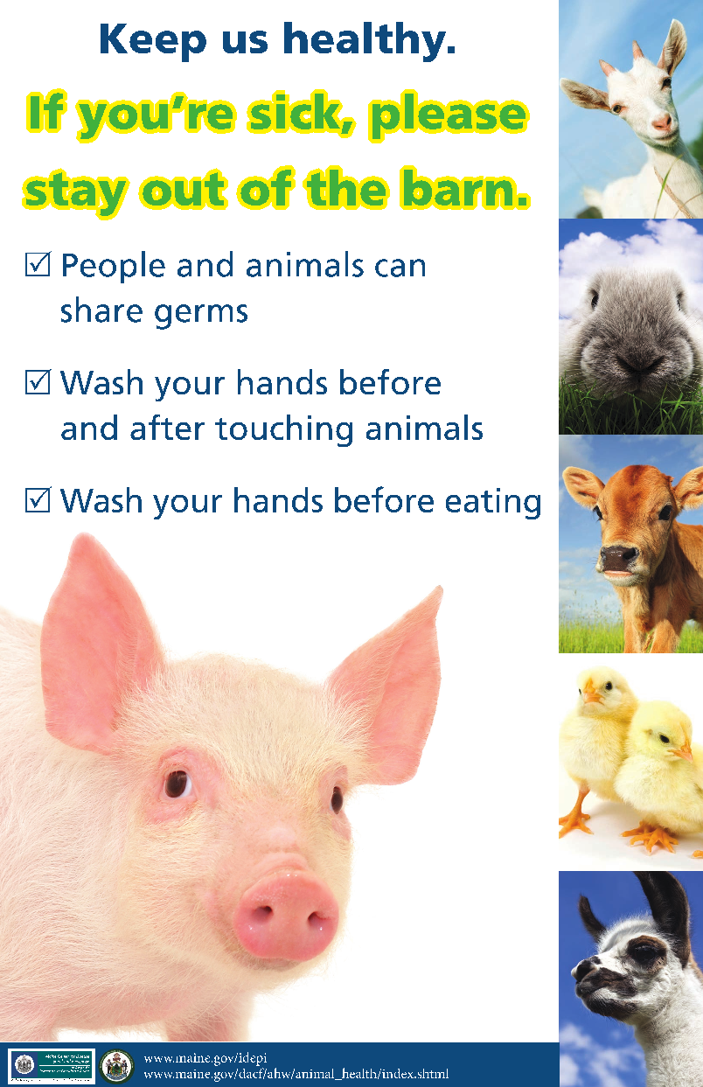
What diseases are the highest risk at a fair/farm?
Influenza
Cryptosporidiosis
Campylobacteriosis
Salmonellosis
E. coli infection
Ascaris infection
Notes:
Although there are many zoonotic diseases, there are a few that are most common, especially concerning livestock. These are the diseases we will talk about today and we will go in to detail about why each of these diseases are considered highest risk at farms and fairs.

Slide 9
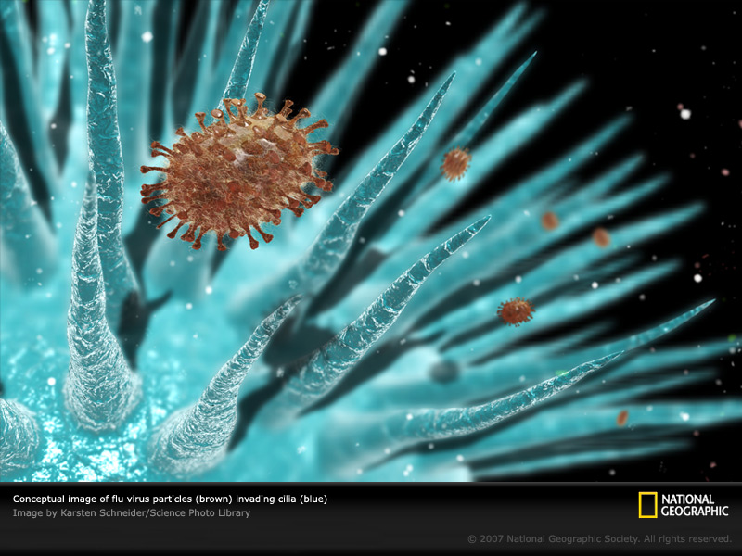
Respiratory Illnesses
Notes:
Our first topic will be respiratory illnesses. Respiratory illness is caused by various different pathogens and infects the parts of your body responsible for respiration, or breathing.

Slide 10
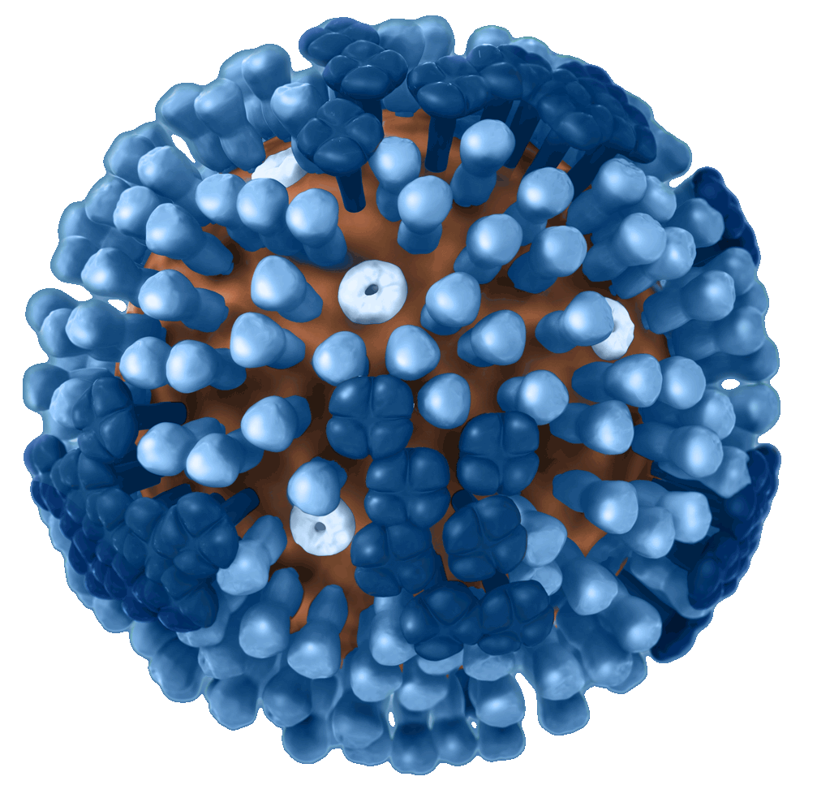
Influenza – what is it?
Commonly know as the flu
Can infect humans and animals
Contagious as early as one day before symptoms develop
Spread by bodily fluids
Signs and symptoms in all species include runny nose, fever, cough, overall lethargy
Notes:
The main group of respiratory disease we will discuss is influenza, which is commonly known as the flu.
There are thousands of strains of influenza, each slightly different and most infecting different types of animals. Seasonal influenza which commonly infects humans is usually one of 4 strains (A/H1, A/H3, B Victoria, or B Yamagata) but there are also strains that can infect birds (such as A/H5 and A/H7) and swine ( such as A/H1 and A/H3). You don’t need to worry about learning each specific strain, however it goes to show just how many there are.
People and animals infected with the flu can spread this disease as early as one day before symptoms develop and is done so by the spread of bodily fluids, typically from coughing and sneezing.
People and animals infected by the flu often display a runny nose, cough, fever, and overall lethargy (leth-er-gy, or undue tiredness).

Slide 11
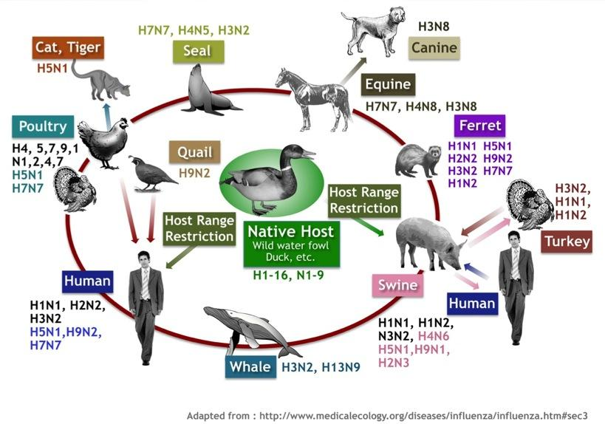
Who gets the flu?
The short answer – everyone!
Pigs, birds, humans are most common
  Population size
Ferrets and other household pets may be at risk
  A strain of bird influenza infected almost 400 cats at a shelter in New York in 2016
Cases documented in whales, dolphins, wild animals
Notes:
There are strains of influenza that infect virtually all animals, including whales and dolphins! Even most household pets can get the flu, and some, like ferrets, can catch human strains of the flu. In 2016, almost 400 cats at a New York shelter contracted a strain of influenza that typically only infects birds.
The strains of influenza that infect swine, birds, and humans are most concerning due to the large amount of pigs, birds, and humans around the world and how closely they interact.

Slide 12
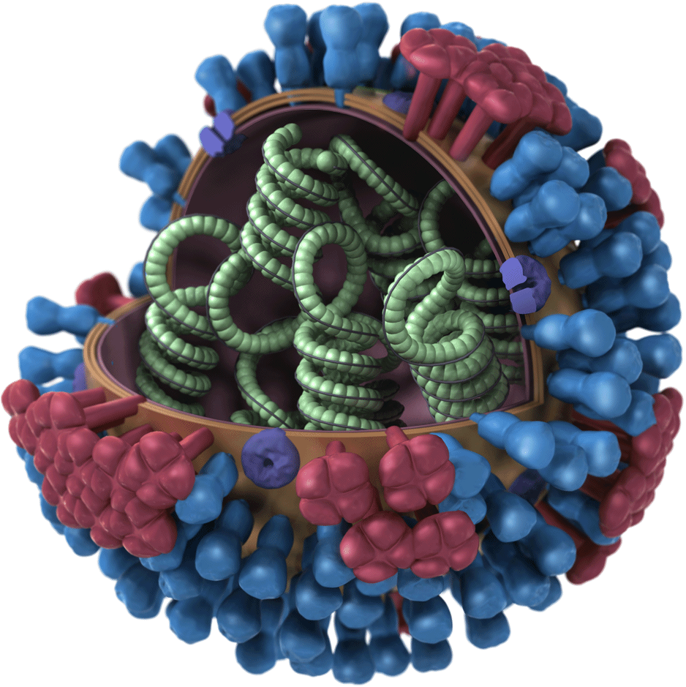
Why is the flu so dangerous?
Influenza can be deadly, in humans and animals
The influenza virus changes often (mutates) making it difficult to control with vaccination or immunity after infection
Diseases once limited to one species can mutate to infect others
Notes:
Influenza can be very deadly, even for completely healthy animals and people. The influenza virus mutates (or changes at a genetic level) very often, making it very difficult to control with vaccination. Typically people become immune to a virus after being infected once, meaning their body recognizes the virus very quickly and can fight it off, usually before any symptoms can even develop. Immunity rarely protects organisms from the flu since the virus can mutate so much that it is completely unrecognizable to the body.
Mutations often occur in the process of the virus being copied. This can either be deadly to the virus (a fatal mistake in the copying process) or beneficial, such as ones that allow the virus to infect other species.

Slide 13
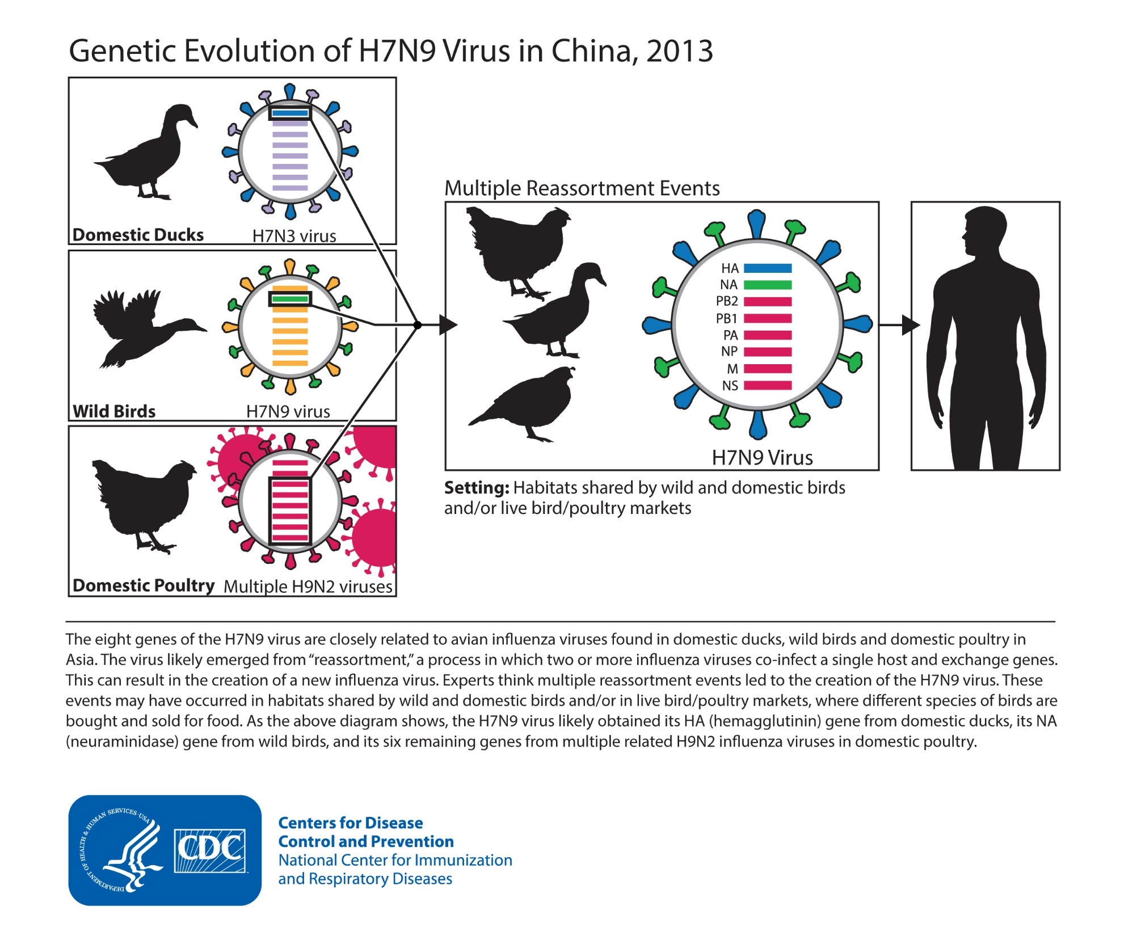
Notes:
What this slide shows is that genes from different viruses that had infected different animals can recombine and infect something new.

Slide 14
Influenza Signs and Symptoms
In Animals
In Humans
Fever
Coughing
Runny eyes
Runny nose
Trouble breathing
Overall lethargy
Diarrhea – rare
Vomiting – rare
Fever
Cough
Sore throat
Runny/stuffy nose
Muscle or body aches
Headaches
Lethargy/Tired
Diarrhea – rare
Vomiting – rare
Notes:
The symptoms of the flu are usually the same for any animal, but we will go over the specifics of what influenza looks like in pigs and domestic birds, mainly being chickens.
Symptoms usually include a fever, coughing, runny eyes, runny/stuffy nose, trouble breathing, muscle/body aches, and overall lethargy (leth-er-gy). Diarrhea and vomiting are actually rare symptoms of influenza, even though this is what people typically label as ”the flu”. The norovirus is commonly the “stomach bug” responsible for causing these symptoms, not influenza.

Slide 15
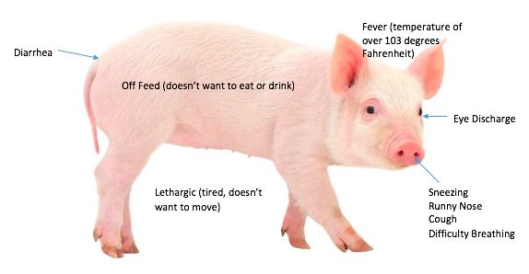
Influenza Signs and Symptoms in Pigs
Signs and symptoms: off feed, runny nose, coughing, tired
  By the time these signs and symptoms hit, they are already shedding this virus, potentially exposing you or other pigs
http://www.strangehistory.net/2016/08/18/pig-in-a-rock/
Notes:
Influenza presents in pigs similar to how it presents in humans. Pigs will go off feed, have a fever, show respiratory distress, and be lethargic.
There is a vaccination available, but not readily.

Slide 16
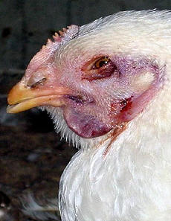
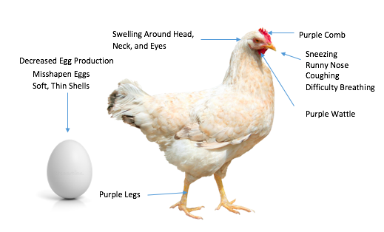
Influenza Signs and Symptoms in Birds
Sudden increase in flock deaths
Sneezing, runny nose, coughing, difficulty breathing
Decreased egg production
Swelling around the head, neck, eyes
Purple wattles, combs, legs
Misshapen eggs or soft, thin shells
http://www.thepoultrysite.com/articles/275/avian-influenza-in-poultry/
http://kindersay.com/signs/chicken
https://www.dreamstime.com/stock-photo-chicken-egg-white-single-isolated-background-image54462011
Notes:
Influenza symptoms in birds include:
A sudden increase in the number of birds in the flock that are dying (this will be more prevalent in large flocks). Birds also will have a lack of energy, and not seem like they want to eat
Issues in their respiratory tract: Sneezing, runny nose, coughing, gasping for air
Issues making their eggs: They will make fewer eggs, the eggs will be misshapen, or have thin shells that are soft
They also will have swollen heads, necks, or eyes and they will have purple colored wattles (below their chins), legs and combs (on their heads). They may also have watery, green diarrhea.

Slide 17
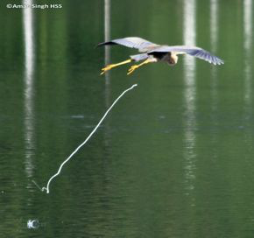
Concerns with Avian Influenza
Wild bird populations can carry avian influenza without symptoms
  Migratory populations
Contaminate water (For example: farm ponds) via “fecal bombs”
Potential for large outbreaks
if viral material comes in
contact with domestic birds
http://www.besgroup.org/2010/12/11/purple-heron-flight-landing-sequence/
Notes:
Why avian influenza is high risk:
They can get it by being around sick birds or sick people
The bird flu is carried by wild water fowl: Birds like ducks and geese that travel to different parts of the country for winter.
When these birds pass through a new area, they can have the flu and pass it through the water they drink or swim in, or if they come into contact with other birds.
The flu can also be spread through the droppings of the migratory birds, so if another bird comes in contact with them, it can get sick
When they poop, they release “fecal bombs” with many copies of the virus that can then live in the water that they land in and spread to domestic birds, and then potentially people
There are around 10 billion chickens in the United States alone, so there is a potential for a large outbreak with avian flu. That is why prevention for this disease and others is so important for human health as well as animal health especially.

Slide 18
Everyday Prevention of Influenza
Humans
Animals
Wash hands frequently
Vaccinate
  Annual seasonal vaccine for humans
Watch for signs of illness in animals and yourself
  If you are sick, minimize contact with animals
  If your animal is sick, minimize contact with other animals and humans
Keep area clean
Biosecurity & Quarantine
  Especially in events where new people/animals are introduced (like at fairs)
Vaccinate if available
Keep away from other sick animals or sick people
Consult a veterinarian
… and safe interaction between humans and animals
Notes:
The good news about influenza is that there is a lot we can do right at home to prevent this disease.
Humans should: wash hands frequently, get vaccinated annually, watch for signs of illness in animals, other people, as well as yourself and react appropriately.
Animals should: have a clean area, be vaccinated (if one is available), be kept away from other sick animals or people, be quarantined if necessary & have a bio-secure area (something we will talk about later in the presentation)
The key to prevention is having safe interactions between humans and animals (being mindful of current and potential illness and acting accordingly)

Slide 19
Prevention of influenza in birds
NO indirect or direct contact between wild birds and domestic birds
  Keep domestic birds away from water where wild birds are able to bathe/live/feed
  Do not allow domestic birds in areas where there may be wild bird droppings.
  Keep food and water indoors
Keep their environment clean and well ventilated.
Do not share equipment from different flocks
Notes:
Because wild birds can carry the avian influenza virus without showing any signs, it’s important to keep domestic birds who are not immune to this virus away from any wild birds.
Wild birds should not be able to access domestic birds so keep them away from areas where wild bird bathe, live, or feed and keep their food and water in a place that wild birds will not be able to access
Keep environment clean (OneHealth)
Do not use equipment from other flocks

Slide 20
Prevention of influenza in swine
Keep environment clean and well-ventilated
Do not share equipment with other herds
Vaccinate if one is available
If any of your pigs are sick, minimize contact with other animals and humans
  Separate sick pig from others if necessary
  Contact your veterinarian ASAP if your pig has symptoms of influenza
AND DON’T BRING THEM TO THE FAIR!!
Notes:
Prevention of influenza in pigs is similar to the same ideas we have discussed previously
A clean and well ventilated environment will make infection less likely and help to prevent the spread of the disease
Do not share equipment with other herds as this could potentially spread the virus before you are even aware it exists
Vaccinations may not be available to smaller farms, however it is good to vaccinate if one is available to you or your farm
If you do notice symptoms that resemble influenza you should
Separate the sick pig from others
Minimize contact between pigs (especially those displaying symptoms) as well as humans
Contact a veterinarian ASAP if you suspect your pig may have influenza
Reacting fast may allow you to get a handle on the outbreak before it gets out of control
Do NOT bring sick pigs or any animal to the fair or any other public area (this may seem obvious, but it is extremely important)

Slide 21
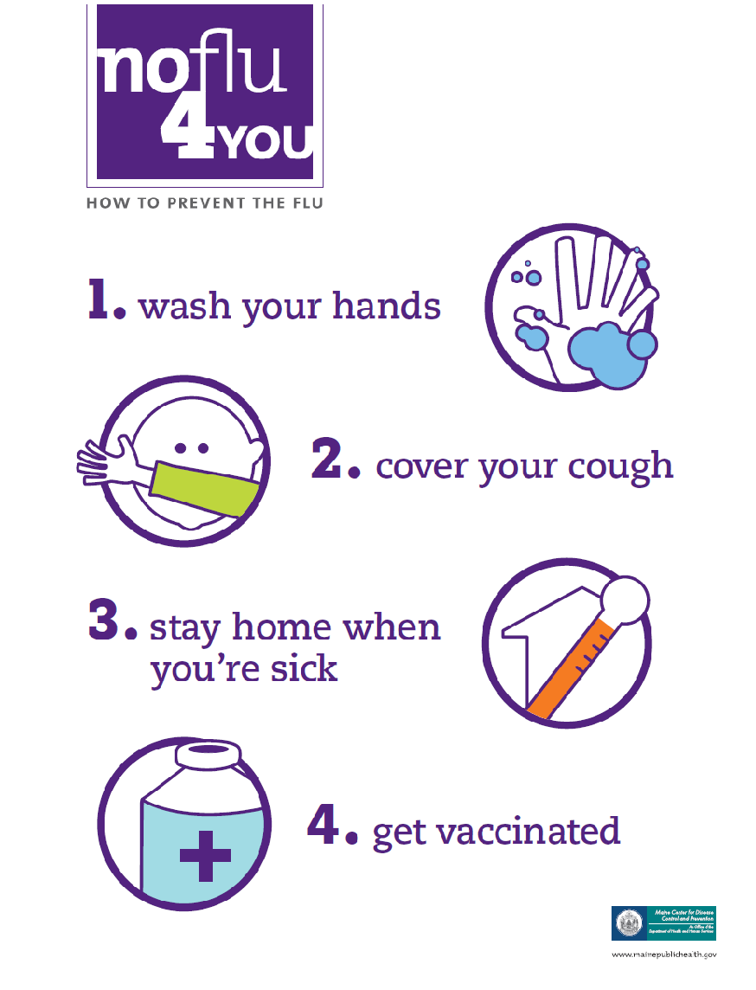
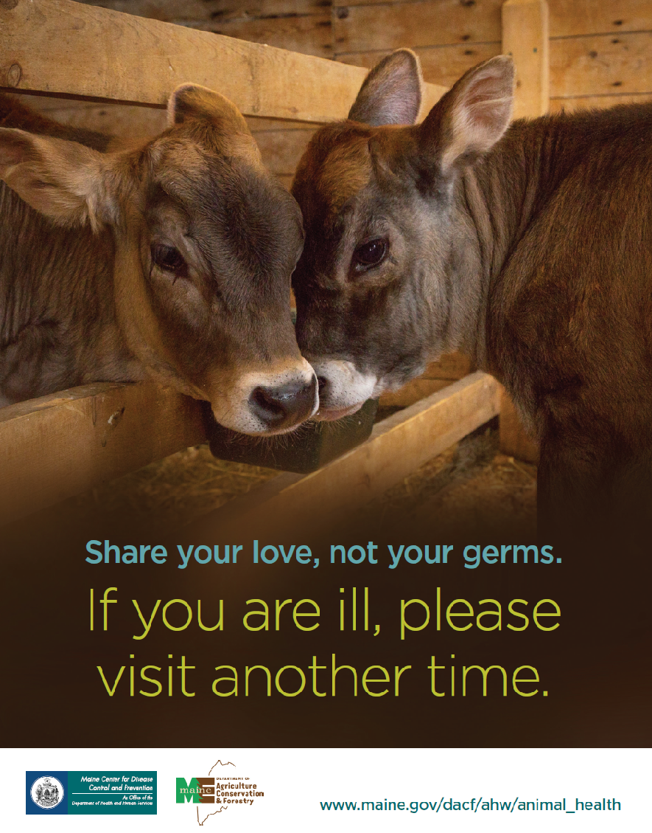
Notes:
Here are examples of posters available through the Maine CDC and Department of Agriculture for display at farms and fairs. Both of these really emphasize influenza prevention in regards to hand washing, safe interactions, and vaccination.
Both of these posters and more are available online for free through the Maine CDC website.

Slide 22
I think I or my animal is sick. What do I do?
Animals
Humans
If your animals show signs and symptoms of influenza – please call your veterinarian
Keep sick animal away from other animals and people
If you’re experiencing a fever greater than 100 degrees Fahrenheit, a cough, and a sore throat, please call your healthcare provider.
SPECIAL NOTE: If you have influenza and have contact with pigs and chickens, please mention this to your health care provider so they can send your test to the state lab. Only the state lab can tell if influenza came from a pig or other species.
Notes:
Recognizing that an animal (or yourself) is sick and acting appropriately can be the difference between a huge outbreak and a small one.
If an animal shows signs of influenza:
a veterinarian should be contacted immediately and your concern of influenza should be noted.
From there, a veterinarian can access the symptoms of the animal and act accordingly from there
The sick animal should be kept away from other animals and people
If you believe you are showing signs of influenza:
Contact a health provider as soon as possible and let them know if you have had contact with pigs or chickens (especially sick ones). They will then be able to send your test to the state lab, as only they can tell if the influenza came from a pig or other species.

Slide 23
Questions?
Notes:
Before we move on, does anyone have any questions regarding influenza?

Slide 24
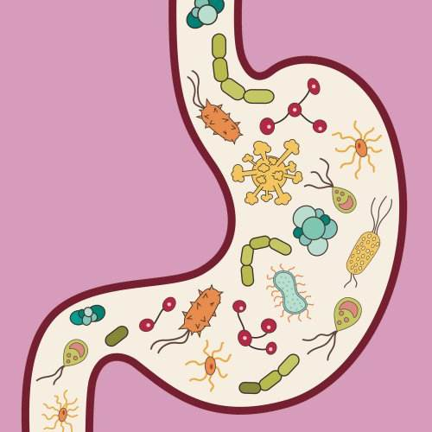
ENTERIC ILLNESSES
Notes:
Next we will talk about enteric illnesses. Does anyone know what an enteric illness is?

Slide 25
What is an enteric illness/disease?
Group of diseases that cause enteric (or intestinal) issues
  Foodborne illnesses
Spread through ingestion of contaminated food/water, contact with infected bodily fluids, direct and indirect contact with infected animals or people
Often have severe and prolonged signs and symptoms
Often have longer incubation periods
Notes:
Enteric illnesses are caused by a group of pathogens that live in the intestines of their host and cause intestinal issues. You may have heard some of these diseases referred to as “foodborne illnesses”
These diseases are spread through the ingestion of contaminated food/water, contact with infected bodily fluids, and direct or indirect contact with infected animals or people
Some of these bacteria and parasites can live on surfaces for months and even years. Because of this, it is always important to wash your hands after being around animals or anywhere animals have been and recognize that these pathogens may exist in the environment and surroundings and not necessarily just the animals.
These diseases can have severe and prolonged symptoms and often have longer incubation periods. Healthy people are still at risk for serious infection by these diseases, however younger kids, older adults, and immunocompromised people are at a very high risk of contracting these diseases and having severe symptoms

Slide 26
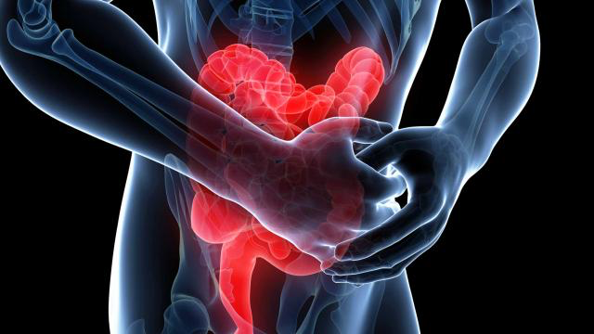
Signs and Symptoms of Enteric Illnesses in Humans
Diarrhea
Nausea
Stomach pain
Vomiting
Fever
Worms in feces (Ascaris)
http://www.askdrmanny.com/ulcerative-colitis/
Notes:
A basic list of symptoms for enteric illness in humans includes:
Diarrhea
Nausea
Stomach pain
Vomiting
Fever
Worms in feces (Ascaris)
Now let’s talk about what the main pathogens are that cause this.

Slide 27
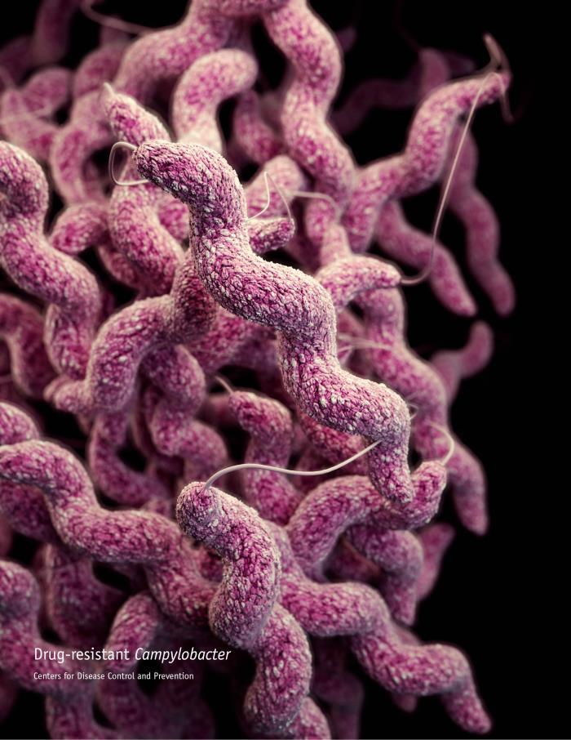
Campylobacter
What is it?
Signs and Symptoms
Bacteria
Also known as “Campy”
Common hosts: healthy cattle, pigs, poultry, livestock, pets
Potential hosts: humans, virtually any animal
Incubation period: 2-5 days
Length of Signs and Symptoms: 1 week
Lives in intestines of healthy animals and is spread by feces
In humans: diarrhea (often bloody), fever, abdominal cramps, nausea, vomiting
In animals: none
Notes:
Campylobacter “Campy”
Campylobacter is bacteria, and we call it Campy for short.
Campy is found in the intestines of most healthy animals like cattle, pigs, poultry and pets. They shed it in their feces, and it spreads through the fecal-oral route. (This is when the pathogen is accidentally eaten along with small amounts of feces)
People usually get infected with Campy by coming in contact with poultry that are infected, but show no signs. The bacteria is also spread through water.
People infected with Campy usually start noticing symptoms 2-5 days after being exposed to the bacteria and stay symptomatic for about a week.
Symptoms in humans often includes diarrhea (often bloody when it does occur), fever, abdominal cramps, nausea, and vomiting. Animals, and especially adult animals, will often not show any signs of having this pathogen as it can exist in their bodies without causing harm.

Slide 28
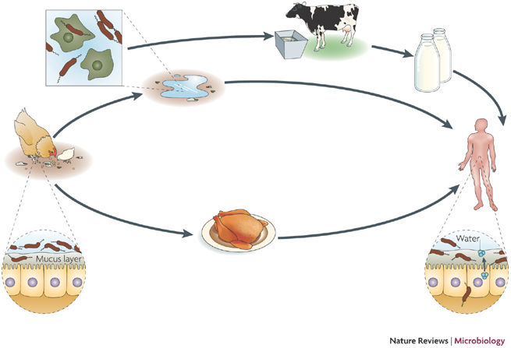
Campylobacter
Why is it high risk?
How common is it?
Animals can carry it without showing any signs and symptoms
  Even healthy animals can shed this bacteria
Bacteria can be spread weeks after signs and symptoms stop
1 in every 1,000 people infected with Campy will develop Guillain-Barré syndrome (GBS)
Approximately 1.3 million human cases in the United States each year
232 human cases in Maine in 2017
https://www.nature.com/articles/nrmicro1718
Notes:
Campy is high risk because of the fact that animals can carry and spread this bacteria without showing any signs or decrease in health. If symptoms do occur, the bacteria can still be spread for weeks after these symptoms stop.
Another reason Campy is a concern is due to its correlation with Guillain-Barre syndrome. About 1 in every 1,000 reported Campylobacter illnesses leads to Guillain-Barré syndrome (GBS). GBS happens when a person’s immune system is triggered by an earlier infection, such as Campylobacter infection. GBS can lead to muscle weakness and sometimes paralysis that can last for a few weeks to several years, and often requires intensive medical care. Most people recover fully, but some have permanent nerve damage, and some have died of GBS. As many as 40% of GBS cases in the United States may be triggered by Campylobacter infection.
Campylobacter is pretty common in the United States with approximately 1.3 million human cases each year. In 2017, there were 232 human cases just in Maine.

Slide 29
Cryptosporidium
What is it?
Signs and Symptoms
Parasite
Also known as “Crypto”
Common Host(s): Cattle
Potential Hosts: Virtually any animal
Incubation Period: 2-10 days (average of 7 days)
Length of Signs and Symptoms: 1-2 weeks
Lives in intestines of host and is shed through feces
In humans: stomach pain, dehydration, nausea, vomiting, weight loss, fever
In animals: typically diarrhea in young animals, however adult animals are often asymptomatic
Notes:
Cryptosporidium:
Cryptosporidium is a parasite, and we call it “Crypto” for short.
Crypto commonly infects cattle and calves. Once it infects a person or animal, it lives in their intestines, and it is shed, or comes out, in their feces.
They can also shed the parasite into water, and then it can get on the food you eat and the water you drink
People infected by Cryptosporidium generally start showing symptoms 2-10 days after exposure to the parasite. 7 days is the average incubation period. Once symptoms start, they usually last 1-2 weeks.
Symptoms of Crypto in humans includes stomach pain, dehydration, nausea, vomiting, weight loss, and fever. Adult animals typically do not show signs, however diarrhea can be present in younger animals infected with this parasite.

Slide 30
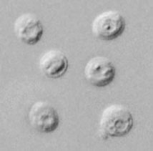
Cryptosporidiosis
Why is it high risk?
How common is it?
Very common in cattle and other livestock
Able to live outside of host for extended periods of time
Able to survive in water
Parasites still spread weeks after signs and symptoms stop
Millions of parasites can be released from a single bowel movement
Almost 750,000 human cases in the United States each year
44 human cases in Maine in 2017
Notes:
Cryptosporidiosis is considered high risk because it’s very common in cattle and other livestock that are typically handled by humans and live in herds.
Animals can be infected for long periods of time, constantly spreading the disease through their feces.
Millions of parasites can be released in a single bowel movement and can still infect other organisms weeks after symptoms stop.
The parasite is also able to survive and infect other animals including humans through water.
Cryptosporidiosis is fairly common in humans, with almost 750,000 cases in the United States each year. There were 44 human cases of Crypto in Maine in 2017.

Slide 31
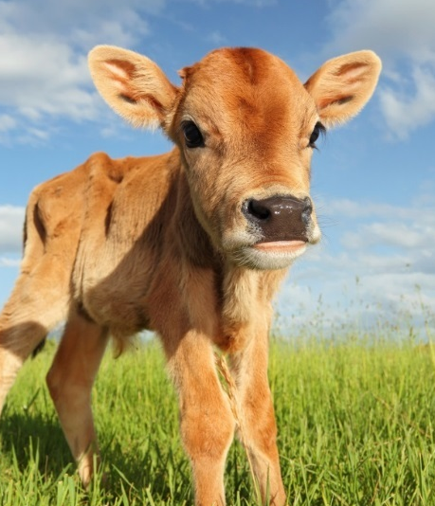
E. coli (STEC)
What is it?
Signs and Symptoms
Bacteria
  Some beneficial, some harmful
  STEC (Shiga toxin-producing E. coli)
Common Hosts: Ruminants (cattle, goats, sheep)
Potential Hosts: Humans, virtually any animal
Incubation Period: 1-10 days (usually 3-4)
Length of Signs and Symptoms: about a week, unless HUS (hemolytic uremic syndrome) occurs, which can last another few weeks and is sometimes deadly
Lives in intestines of infected animals and is spread through feces
In humans (STEC): often varies but often includes sever stomach cramps, diarrhea (often bloody), vomiting, low fever
In humans (HUS): decreased urination, lethargy, loss of pink coloration in cheeks and inside lower eyelids
In animals: none
Notes:
E. coli
E. coli is a bacteria, and there are a few different types. Some are beneficial, and live in our intestines to help us digest food, and some are harmful. If a harmful strain of E. coli is ingested and reaches the intestines, it can cause illness in humans.
The harmful kind of E. coli produces Shiga toxin, and this kind of E. coli typically lives in the intestines of ruminant animals, like cattle. This is what we will be referring to when we talk about E. coli infections.
E. coli is shed in the feces of these animals, and so it gets in their bedding, on their bodies, and on anything they may touch
People infected with STECi generally show symptoms within 1-10 days after exposure to the bacteria, with the average being 3-4 days. Symptoms usually last about a week unless further complications occur.
Around 5–10% of people diagnosed with STEC infection develop a potentially life-threatening complication known as hemolytic uremic syndrome (HUS), a type of kidney failure. People with HUS should be hospitalized because their kidneys may stop working and they may develop other serious problems. Most people with HUS recover within a few weeks, but some suffer permanent health problems or die.
People infected with STEC have varied symptoms, however most display severe stomach cramps, diarrhea, vomiting, and a low fever. People who develop hemolytic uremic syndrome will display decreased urination, lethargy, and the loss of pink coloration in the cheeks and inside the lower eyelids. Animals generally will not display symptoms.

Slide 32
Shiga Toxin-Producing E. coli
Why is it high risk?
How common is it?
This bacteria lives naturally in animals, especially ruminants (cattle, sheep, goats, buffalo, deer)
  Animals often do not show symptoms but can spread it
Approximately 100,000 cases in the United States each year
35 human cases in Maine in 2017
2 human cases of HUS in Maine in 2017
Notes:
E. coli is a high risk disease because it’s typical hosts, ruminants, are often directly handled by people. Ruminants are animals that have multiple stomach compartments such as cattle, sheep, goats, buffalo, deer, and more. These animals will generally not show symptoms when they have this bacteria, so even healthy animals can pass on this bacteria.
E. coli in humans is not as common as the other disease, however it is just as dangerous. There is approximately 100,000 human cases of STEC infections every year in the United States. There were 35 human cases in Maine in 2017 along with 2 cases of HUS. HUS, like previously discussed, is a type of kidney failure that can sometimes be fatal.
32

Slide 33

Salmonella
What is it?
Signs and Symptoms
Bacteria
Common hosts: Chickens, reptiles, amphibians, livestock
Potential Hosts: humans, virtually any animal
Incubation Period: 12-72 hours
Length of Signs and Symptoms: 4-7 days
Lives in intestines of animals and is spread by feces. Raw meat, eggs, or milk from infected animals can also contain this bacteria
In humans: diarrhea, fever, abdominal cramps
In animals: none
Notes:
Salmonella:
Salmonella is a bacteria.
Salmonella is carried by many species, however most human infections are from exposure to chickens and reptiles
People infected with Salmonella generally start showing symptoms within 12-72 hours after exposure. These symptoms usually last 4-7 days.
Symptoms in humans often include diarrhea, fever, and abdominal cramps. Animals will generally not show symptoms of salmonella.
Salmonella lives in the intestines of infected animals and is spread by their feces. Raw meat, eggs, or milk from infected animals can also transmit this disease.

Slide 34
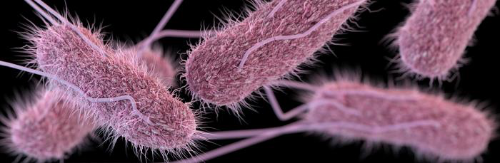
Salmonella
Why is it high risk?
How common is it?
Virtually any animal including common household pets such as dogs and cats can spread salmonella without showing signs and symptoms
Approximately 1.2 million human cases each year in the United States
102 human cases in Maine in 2017
Notes:
Salmonella is a big concern as virtually any animal including household pets such as dogs and cats can get this disease and some will not show symptoms.
Salmonella is fairly common in the United States with 1.2 million human cases each year. In 2017, there were 102 human cases of salmonella infections in Maine.

Slide 35
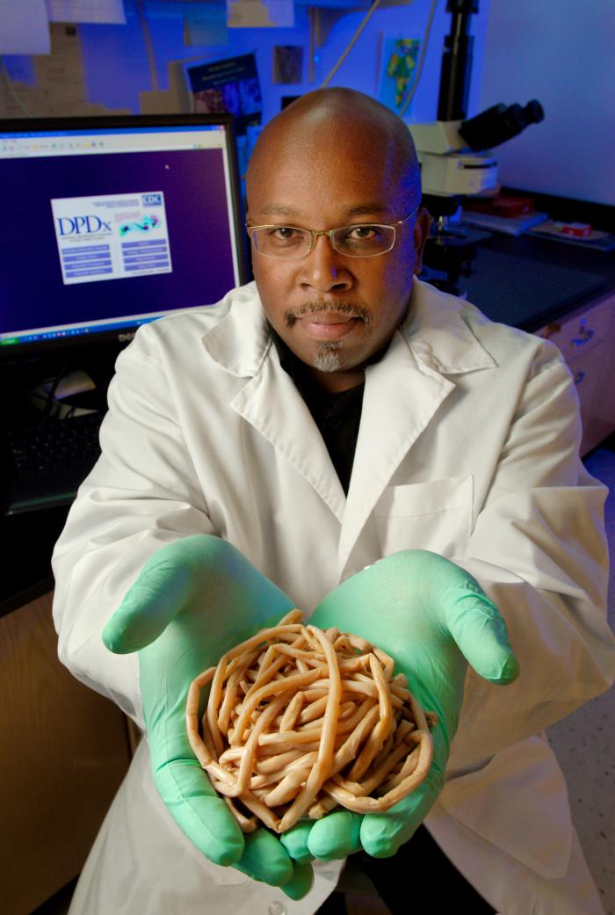
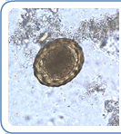
Ascaris
What is it?
Signs and Symptoms
Parasite (roundworm)
Common Hosts: pigs
Potential Hosts: humans, virtually any animal
Incubation Period: up to 8 weeks (time for ingested egg to develop into an adult)
Length of Signs and Symptoms: indefinite, adults can live for years
Lives in intestines, transmitted through feces
In humans: often none; sometimes light abdominal discomfort
  Heavy infections can cause intestinal blockages, coughing, impaired growth
In pigs (and other animals): usually none
Notes:
Ascaris is a type of roundworm that is most common in pigs, however it can infect virtually any animal.
Worms have life cycles:
They infect pigs when they are living as eggs in the soil
Once eaten by a pig, the egg can grow into an adult
The adult releases more eggs within the intestine of the pig, and these are shed into the soil
Occasionally an adult worm will be passed in the feces as well…they can be over a foot long!
Mostly transmitted through pig feces-the eggs get mixed in with soil and can live there for years.
In order to prevent this:
Pigs need to be dewormed at least yearly, and maybe more for younger pigs
If infected, keep them away from growing vegetables, and don’t use their manure or bedding
Always wash produce before eating.
People will start to show symptoms around 8 days after exposure to Ascaris, which is the time it takes for an ingested egg to develop into an adult. Symptoms can last indefinitely, as adults Ascaris worms can live for years.
People generally will not show symptoms other than light abdominal discomfort. Heavy infections can result in intestinal blockages, coughing, and impaird growth. Pigs and other animals generally will not show symptoms.

Slide 36
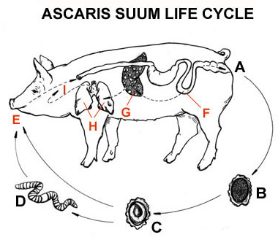
Ascaris
Why is it high risk?
How common is it?
If manure of infected pig (or other animal) is used for fertilizer, it can contaminate the produce grown in the area the fertilizer was used
Eggs can live in soil for years (up to 15)
Animals often do not show signs and symptoms
Potential to cause serious internal damage
Over 1,221 million people worldwide are thought to be suffering with ascariasis
Now uncommon in the United States
Notes:
Ascaris eggs can live in soil for years and can contaminate anything grown from this soil or fed on the soil (grazing). The only way to know a pig has this is to get a fecal (test poop for signs of ascaris worms or eggs) and the only way to prevent is to worm pigs regularly.
Ascaris worms can cause serious internal damage such as blockages and can impair growth in kids and younger animals.
Ascaris is somewhat uncommon in the United States but still very much exists. An estimated 807-1,221 million people worldwide are infected with ascaris.

Slide 37
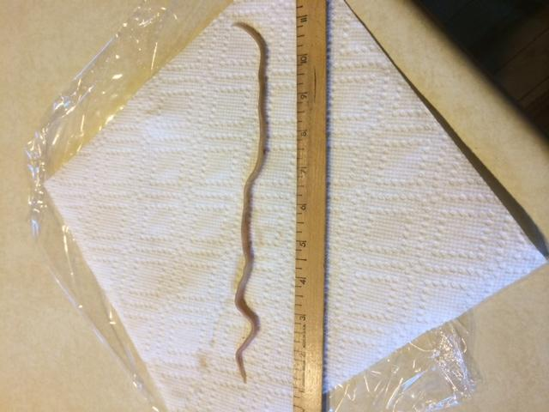
Ascaris from a 4 yr old in Maine!

Slide 38
Prevention of Enteric Diseases
Humans
Animals
Always wash hands after handling animals, their manure, bedding, etc.
Always wash hands and surfaces after handling raw meat.
Always wash produce before serving
Regular deworming for parasites
Keep environment clean
Avoid sharing equipment/allowing contact with other herds
Notes:
Prevention for all of these diseases is fortunately very similar and pretty easy.
Always wash your hands
After being around animals
After touching animals or their feces
Before eating or preparing food
After touching raw meat and poultry
Keep any fruit and vegetables away from raw meat and poultry, and wash your hands after touching it
Wash produce before eating it
Prevention in animals includes regular deworming for parasites and a clean, well ventilated environment. Always avoid sharing equipment and/or allowing contact with other herds as this could potentially spread the parasite from one farm to another.

Slide 39


Slide 40
Questions?
Notes:
Does anyone have any questions regarding enteric illnesses?

Slide 41
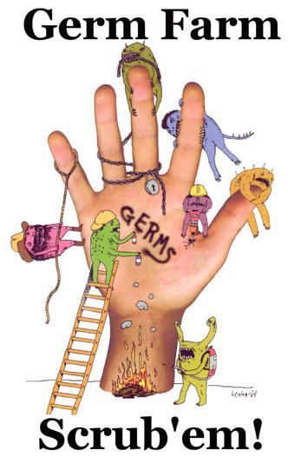
How to wash your hands
Wet your hands with clean, running water and apply soap.
Lather your hands by rubbing them together with the soap.
Scrub your hands for at least 20 seconds.
Rinse your hands well under clean, running water.
Dry your hands using a clean towel or air dry them.
Notes:
Even though this is generally looked over, handwashing is really essential to preventing these diseases. It’s inexpensive, simple, easy, and can be done virtually anywhere. Since most of these diseases cannot be vaccinated against, handwashing is one of the best possible ways to prevent both catching as well as spreading these diseases. Studies have proven the most effective handwashing techniques for preventing the spread of germs.
First, wet your hands, which will help the soap make bubbles better. The bubbles help pick up the germs and move them off of your hands.
Add soap to your hands, and scrub the entire surface of your hands, including the backs of them, in between your fingers, and underneath your fingernails. Make sure to scrub really well, for 20 seconds.
Rinse all the soap and germs off your hands in running water.
Then dry your hands off on a clean towel or air dry them.
*If you don’t have water/soap available, use hand sanitizer, and rub it over your hands until they’re dry

Slide 42
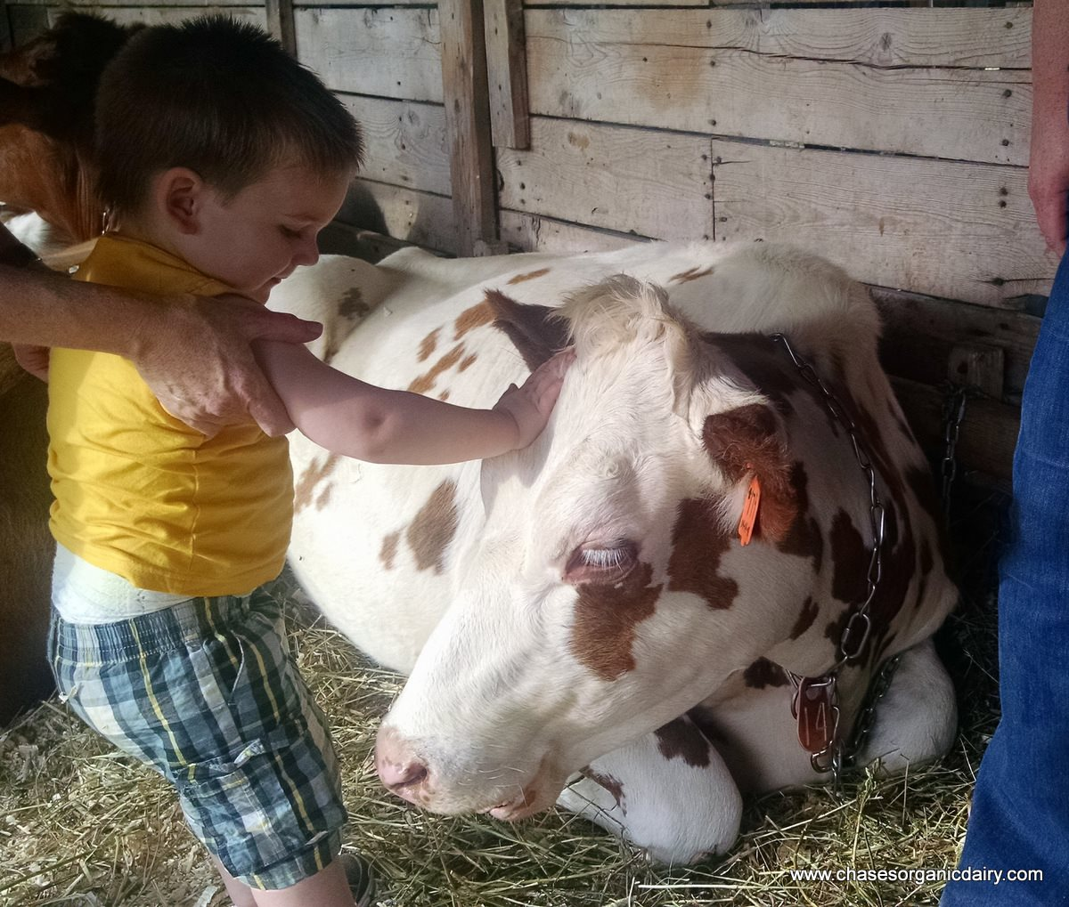
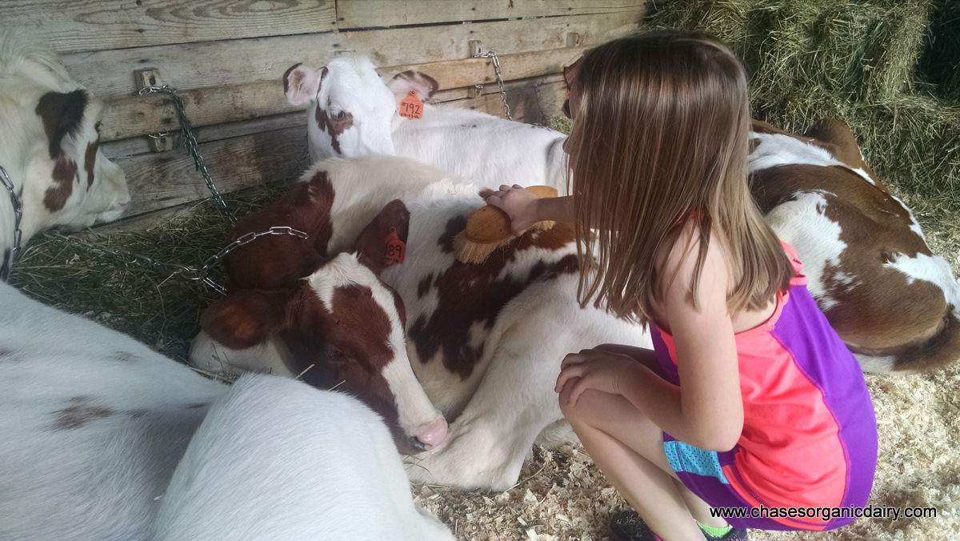
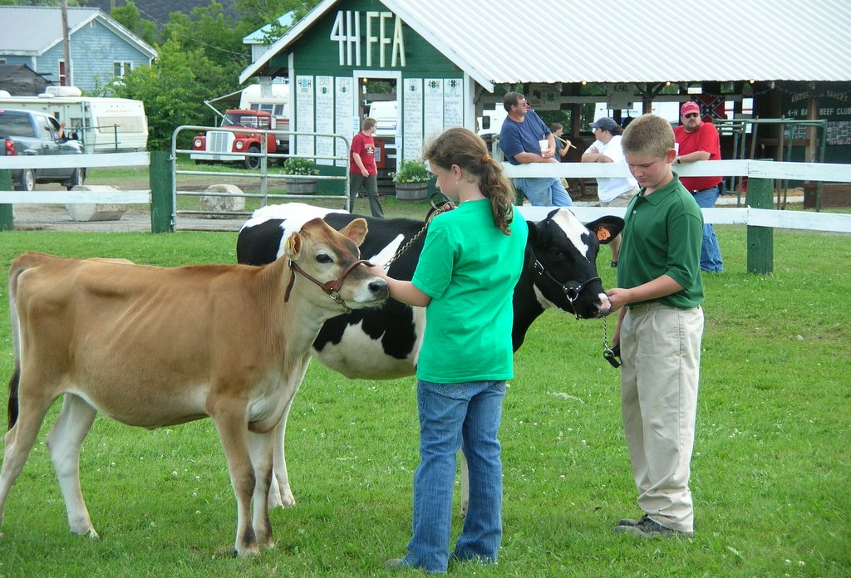
Takeaway:
Even healthy, clean animals can pass on diseases that can hurt people…
So that’s why education about the risks and the effective ways to reduce those risks is the key to healthy fairs!
Notes:
The fact that healthy animals can carry disease is not something everyone is aware of. Most everyone knows to stay away from a visibly sick animal, but who suspects a healthy and robust calf, pig, or chicken to spread a disease that could potentially be very harmful or even fatal?
Education is key to the preventing these diseases as it allows for mindful interactions between humans and animals. Simple steps to prevention such as washing your hands after handling animals or equipment used for animals, yearly worming, and being aware that these diseases are out there can reduce the risk of disease both at fairs as well as at farms exponentially.

Slide 43
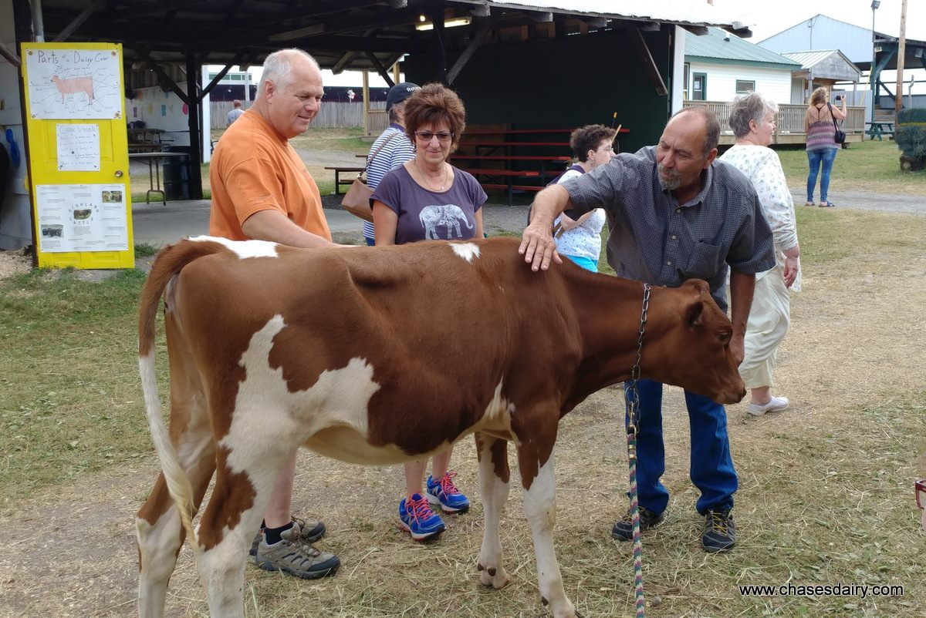
Zoonotic Disease & The Public
Farmers and people with animals willingly take this risk BUT the public is not always aware
  Heathy people may show minimal signs and symptoms, however these diseases can be deadly for young children and anyone with a suppressed immune system
  Our job is to make sure they are aware of these risks
Notes:
Farmers and people with animals willingly take on the risk of potentially being infected with one of these diseases, however the public is not always aware. Healthy people are unlikely to develop severe symptoms and therefore any infections will most likely go unnoticed. Our job is to help make sure people (and especially kids) are aware of these risks and the simple steps that can be taken to prevent them.
And I just really want to emphasize that all of this is NOT to scare people or make things harder for the ag world. We all know things are already hard enough as it is! This is to make things easier and safer. Increased education on these diseases and how to prevent them will make farms, fairs, and anywhere animals and people interact a safer place, not only for humans but for animals, too. People normally do not worry about their illnesses being able to infect animals that they interact with but all of this goes to show that it definitely can. All it takes is one sick person to cause a huge, farm or town wide animal outbreak or one sick animal to cause a human outbreak. I truly would not be standing here if this did not have farm and fair’s best interests in mind, and this does. Humans will never stop interacting with animals and allowing the public to interact with animals is what keeps agriculture alive. We can keep this interaction positive by recognizing even healthy animals may harbor potentially deadly diseases and we should always do what we can to minimize that risk.

Slide 44
Well if all this is true.. Why haven’t I gotten sick?
How many times have you had diarrhea and not known why?
  Signs and symptoms are often overlooked in healthy people (less likely to experience severe symptoms)
  Only way to know for sure is by a fecal test
  Biggest risk is with people who have underdeveloped/challenged immune systems
Notes:
Now I know all of you are probably wondering (as did I) why you haven’t gotten these diseases if you’re constantly around animals. There is no right or wrong answer to this, however it’s important to note that these diseases are likely to cause only mild symptoms in healthy individuals. A healthy adult who contracts a disease such as cryptosporidiosis may only have mild diarrhea for a couple days before it completely resolves on its own, which would commonly be overlooked. The only way to truly know for sure is to get a fecal test at some point during the period diarrhea occurred to test for different bacteria and/or parasites.
While a lot of these cases will not be serious, younger kids, older adults, and immunosuppressed individuals are at high risk for not only contracting the disease but also experiencing far more severe symptoms and even death. Since most do not have a cure and hospitals can only conduct supportive care (meaning treating the secondary symptoms such as diarrhea, vomiting, fever), prevention is the best shot we all have at stopping these diseases.
With that being said, let’s elaborate on ways to prevent these diseases both at the fair as well as at the farm.

Slide 45
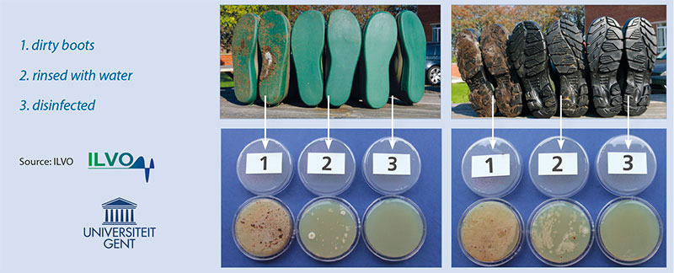
Biosecurity: ”What” and “Why”
Biosecurity is a set of protocols to help prevent the introduction and spread of disease
  Keeping diseases from entering an area
  Preventing disease from spreading to other locations
  Keeps your own herd safe from the introduction of new pathogens
  Helps minimize the spread of existing pathogens
  Helps prevent sickness from spreading TO or FROM humans and animals
http://www.thepoultrysite.com/poultrynews/29797/frequently-forgotten-measures-to-maintain-biosecurity-on-farms/
Notes:
Biosecurity is a set of protocols to help prevent the introduction and spread of disease.
Biosecurity will help to keep your own herd safe from the introduction of new pathogens as well as helping to minimize the spread of existing ones. Biosecurity protects both animals as well as people.
Boot washing is a very effective way of helping to make an area biosecure. This photo shows the bacteria grown from the bottom of boots that have been disinfected, rinsed, or kept dirty.

Slide 46
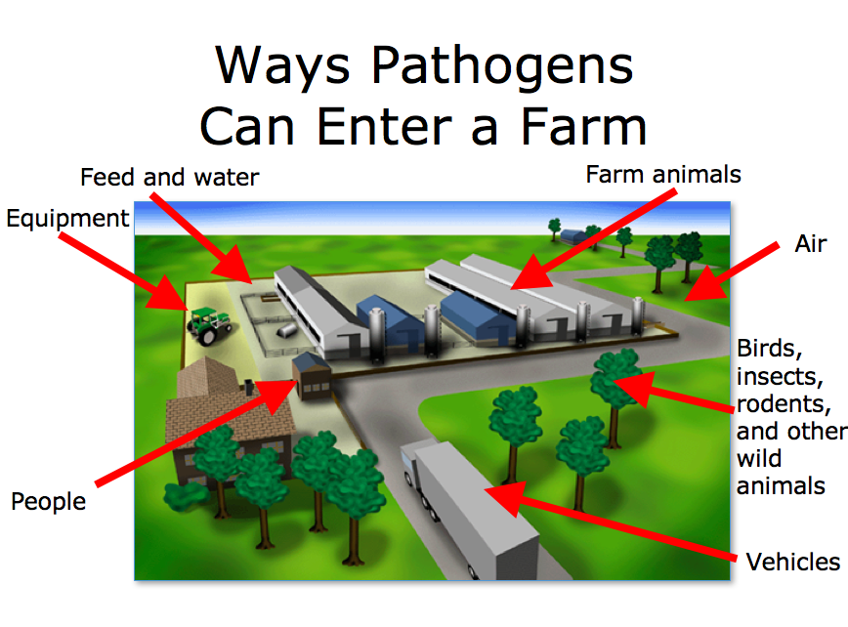

Slide 47
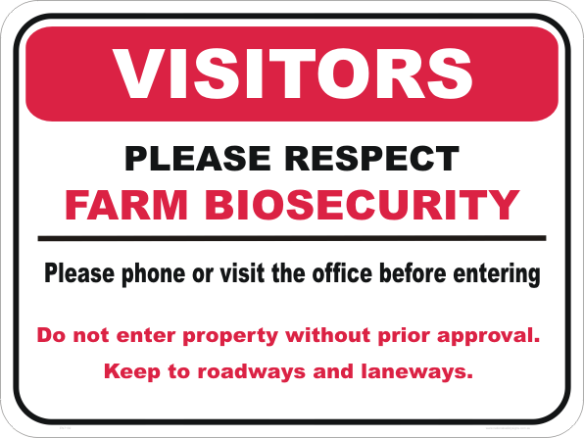
Biosecurity at the Farm
Visitors can carry pathogens inside of the farm on their clothes, boots, their own bodies, or even their vehicles.
  Clean boots and clothes
  Sick? Stay out of the barn!
  Wash hands both before and after
  Don’t share equipment with your neighbor (fomites)
https://nationalsafetysigns.com.au/safety-signs/farm-bio-hazard-sign-en32202/
Notes:
Visitors can carry pathogens inside of the farm and into fair exhibits on their clothes, boots, their own bodies, or even their vehicles.
You can prevent the spread of these diseases on farms and fairs by requiring visitors to have clean boots and clothes as well as going through a boot wash station prior to entering the farm. Any sick people should avoid handling animals unless absolutely necessary, especially outside visitors. Requesting that all visitors wash their hands prior to handling the animals can help stop diseases from being passed on to your herd.
When leaving, it is a good idea to repeat the same steps – washing boots and washing hands. This will prevent any pathogens from your farm to spreading to other farms or infecting people.
Last but not least, do not share equipment with your neighbor to avoid passing pathogens from one farm to another. Fomites, or objects that are likely to carry infectious materials, such as clothes, boots, shovels, and pitchforks can all pass on pathogens from one area or organism to another. If you work at multiple farms, for example, it’s best to have separate clothing and equipment for each farm.

Slide 48
Biosecurity at the Fair
Fairs are educational and fun BUT can be high risk for both animals and people without proper biosecurity
  People can get sick from your animals, or your animals can get sick from people
Encourage healthy interactions between animals and people
  Ask people to wash their hands before and after handling your animals (touching different animals back to back can spread disease from other farms to yours)
  Discourage kissing animals, driving strollers through barns, using pacifiers that could be dropped, etc.
Keep human eating areas away from manure storage and animal areas
Use signage for those you cannot speak to directly
Notes:
Fairs are educational, fun, and are a great way for people involved in agriculture to connect and interact with the public. I don’t know how many times I have heard people call cows “horses and goats “sheep” or vice versa. Without fairs, the public would be potentially losing out on that education and people would be even less in tune with agriculture and where their food comes from. The key, and main point, to this is to encourage HEALTHY interactions between animals and people.
Let people know that they can pass on potentially harmful illnesses to animals and catch potentially harmful illnesses, too.
Ask people to wash or sanitize their hands before AND after handling your animals. Touching several different animals back to back can spread disease from one farm to another, and these diseases can travel back to your farm and infect entire herds.
Discourage situations where pathogens are more likely to be spread, such as kissing animals, driving strollers through barns, and using pacifiers that could potentially be dropped and reused.
Keep human eating areas away from manure storage and eating areas
And please use and encourage the use of signage for those you cannot speak to directly.

Slide 49
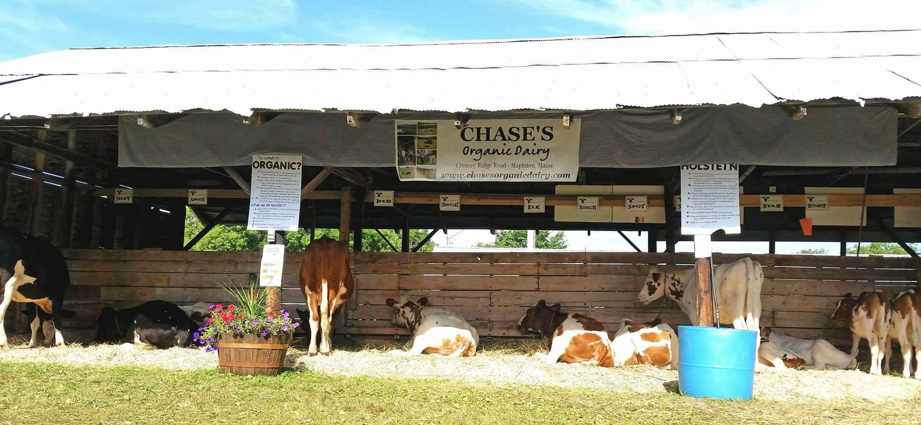
Biosecurity at the Fair cont.
Do not share equipment with other farms
  Even healthy animals can pass pathogens
Keep your area clean and organized
Separate any animals who appear to possibly be sick
Never bring any animals that you suspect are ill

Slide 50
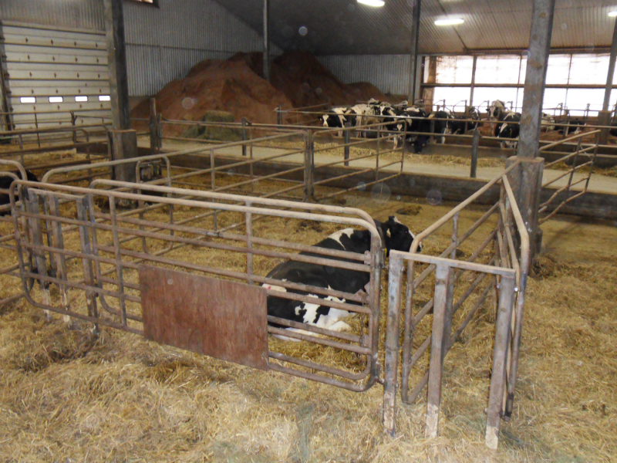
Quarantine
What is it?
When is it necessary?
Quarantine is the process of isolating an animal(s) to prevent the spread of disease between them and the main population.
How do you do it?
Animal must be completely separated.
No shared equipment
Change clothes and boots, wash hands after handling
21 days is the recommended quarantine time to protect against the majority of diseases
When an animal seems sick
When you bring home a new animal
When you bring back animals from the fair!
http://www.biosecuritynovascotia.com/disease-emergency/
Notes:
One very successful method for preventing the spread of disease is by quarantining. Quarantining is the process of isolating an animal or animals to prevent the spread of disease between them and the main population. This can be one of the most effective ways to prevent disease outbreak on your own farm.
In order for quarantine to be successful, the animal must be completely separated. The animals should not be able to touch each other and different equipment should be used for cleaning and feeding the quarantined animals. Since clothes and boots can spread disease as well, a separate set of clothes and boots should be worn when handling the quarantined animals. To prevent against the majority of diseases, a 21 day quarantine is recommended.
I know this can seem like a hassle to some, however this could be the difference between a few animals catching a disease and the entire herd and we all know how awful it is for a whole herd to catch a serious illness, especially if it is a large one. To be safe, new animals should always be quarantined before introducing them in the main herd as new animals can carry disease that your original herd has no defense against. This is true for different species as well. Even my farm fell victim to a wide spread disease when we brought a goat and did not quarantine and our herd fell victim to a diarrheal disease that impacted the entire herd. We even suffered a few loses. Thinking

Slide 51
Questions?

Slide 52
Careers in Public Health
Public Health: Promotes health through prevention
  Behavioral science/health education
  Biostatistics
  Environmental health
  Epidemiology
  Health services administration
  Informatics
  Veterinary Science
Notes:
Careers in Public Health:
If you are interested about what you learned about today, you can consider a career in public health
Public health promotes health in a community through prevention methods
Michele is a Veterinarian and Sara is an epidemiologist, so you can as them some questions about what they do

Slide 53

Further Materials/Info
This PowerPoint and others will be available to you after today
Many of the posters you see here and at today’s workshop are available for free at the ME CDC website:
http://www.maine.gov/dhhs/mecdc/infectious-disease/epi/order-form-wn.shtml
See “Resources” handout for more
information

Slide 54


THANK YOU!
Contact Maine CDC or DACF for any questions or more information
Maine CDC: 1-800-821-5821
Maine DACF: 207-287-3200

